Slide 1

Descriptive Analysis and Data Visualization Project Submission
World Cup Result Analysis

Slide 2
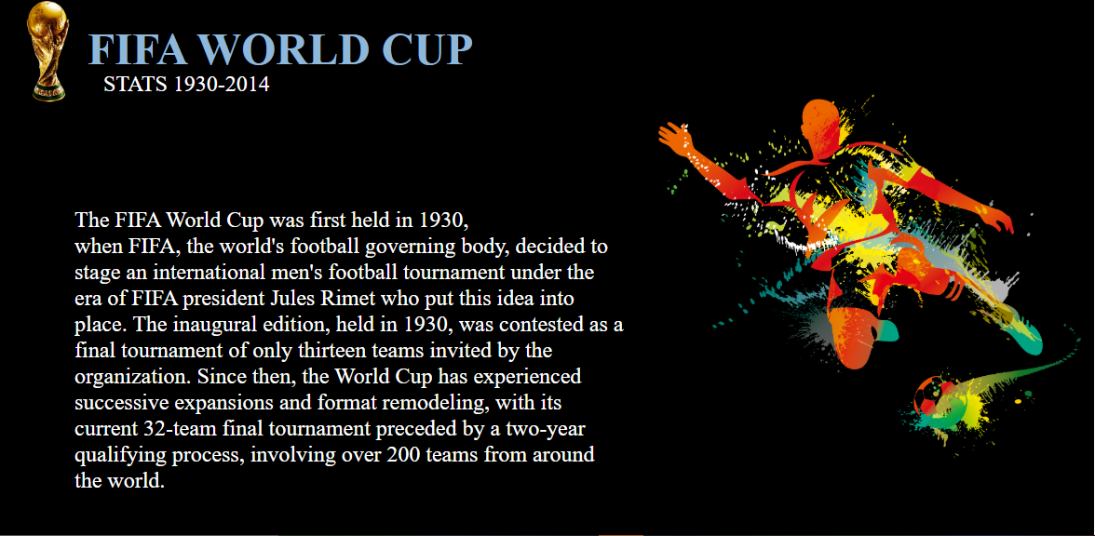

Slide 3
Variables Understanding from the Data Set
Year - The year in which the match was played.
Date - The Date on which the match was played.
Stage - The stage at which the match was played.
Stadium - Stadium name where the match was held.
City - The city name, where the match was played
Home team - Home team’s country name.
Home Goals - Total goals scored by the home team.
Away Goals - Total goals scored by the away team.
Away Team - Away team’s country name.
Matches Played - Total matches played in the Tournament.
Attendance - Total attendance in the Tournament..
Qualified Teams - Total participating teams
Goals Scored - Total goals scored in the world cup tournament.
Fourth - Team who won the fourth place
Third - Team who won the third place
Runner-Up - Team who won the second place.
Winner - Team who won the FIFA world cup

Slide 4
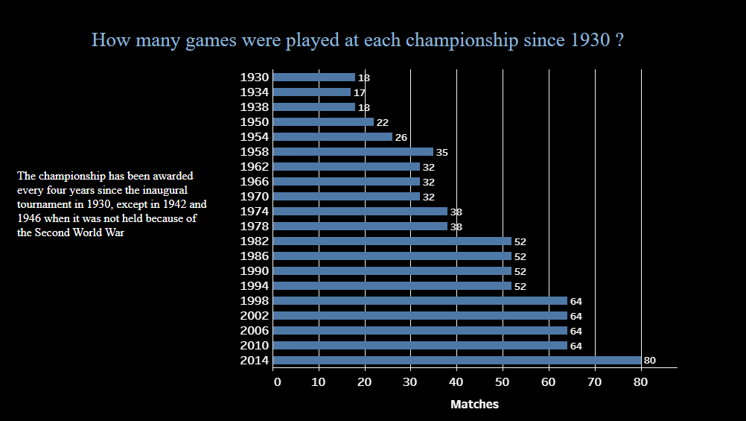

Slide 5
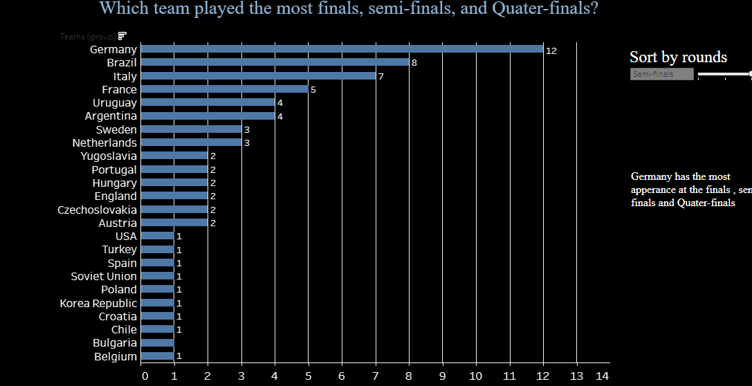

Slide 6
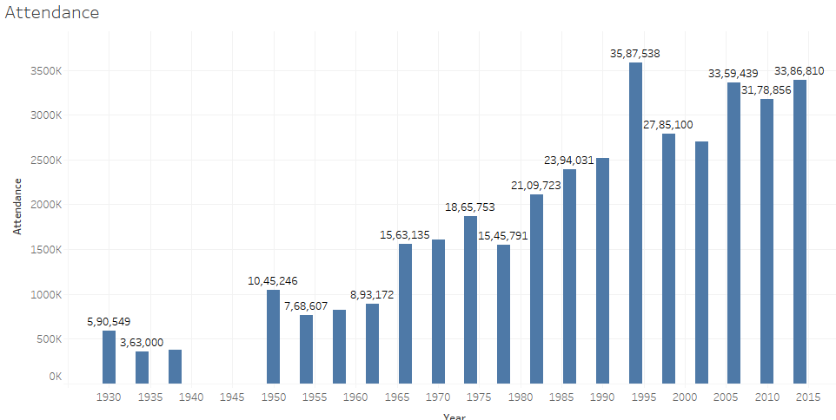
The given visualization depicts the total attendance across world cups 1994 World cup has the highest number of attendance(35,87,538). 1934 World cup has the lowest attendance among all world cups(3,63,000).

Slide 7

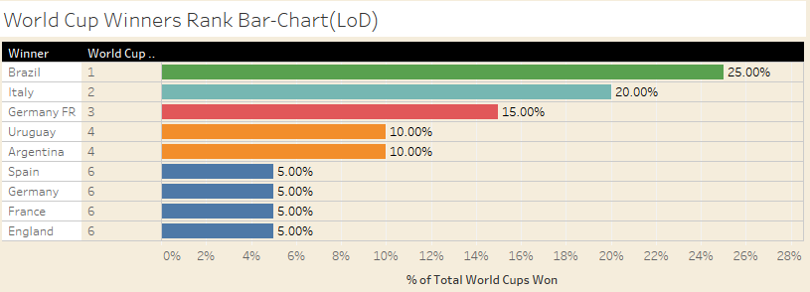
Depicts the LOD of number of World Cups won by each Country.
World Cup Rank is calculated by putting in the sum of world cups won in distinct years.
Out of the 20 world cups, brazil has the maximum worldcups(5) which accounts for 25%.
Germany before unification has won 3 world cups and also won a world cup in 2014 where the total count of world cup takes to 4.

Slide 8
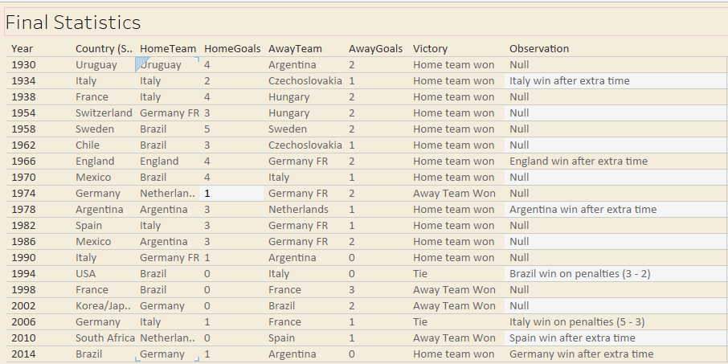
Overall Summary of the world cup (1930-2014)

Slide 9
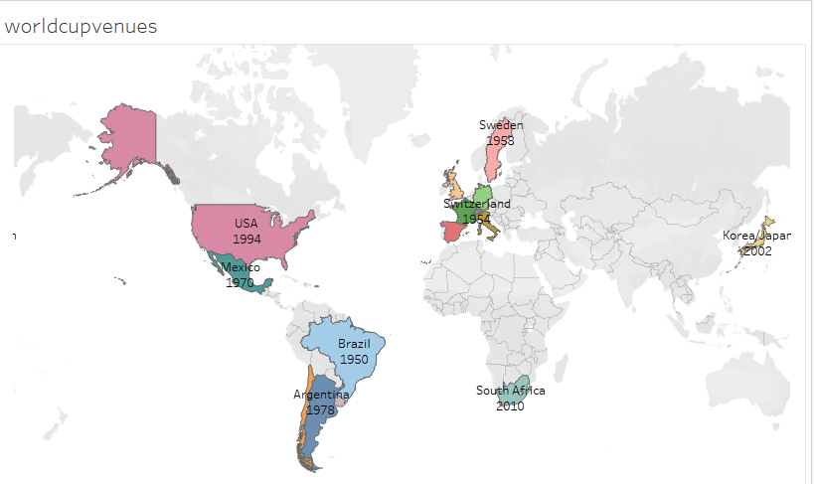

Places where football world cup matches were held from 1930 - 2014

Slide 10
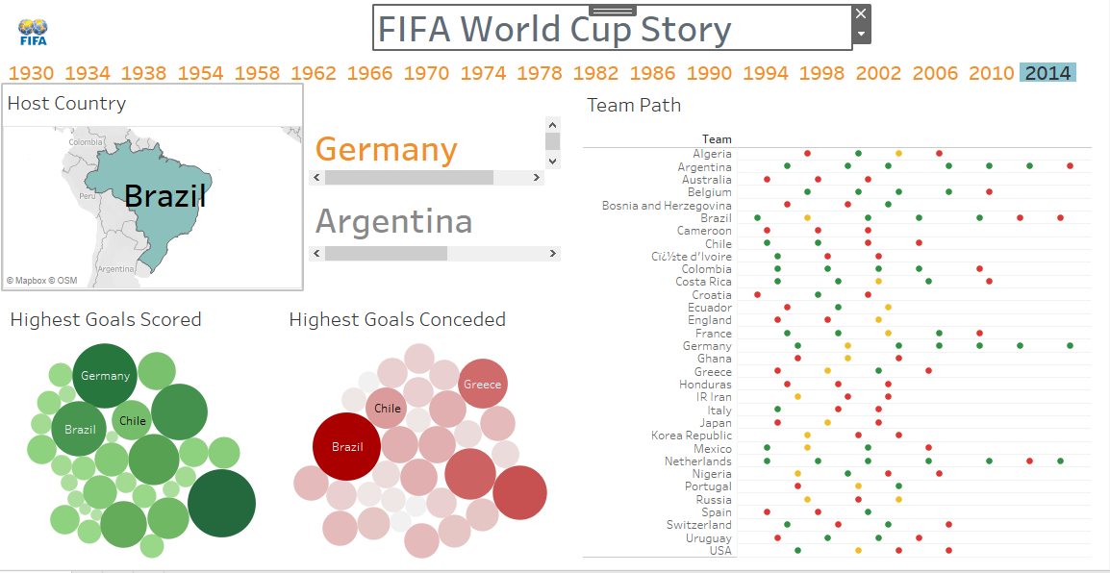
Story of 2014 World Cup

Slide 11
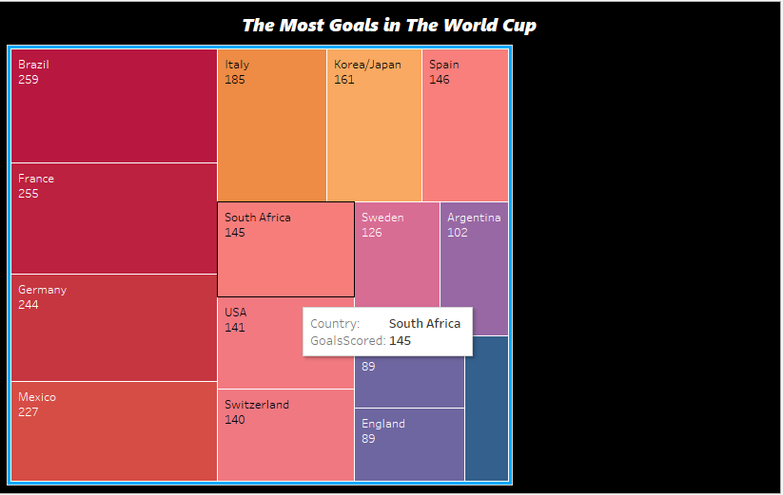
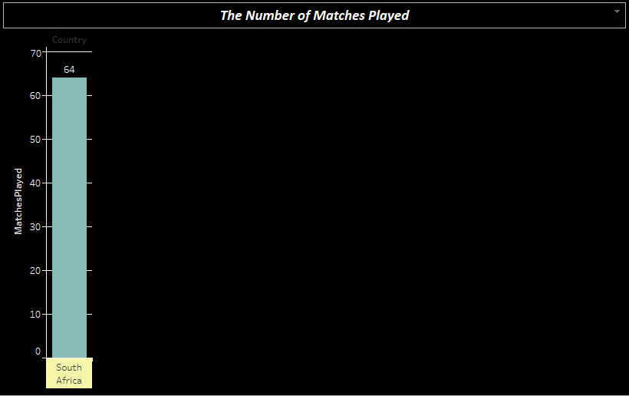
Use of Action Filter Implemented here.
When Number of goals scored by south Africa is selected, it redirects to the other worksheet which gives the number of matches played by South Africa.

Slide 12
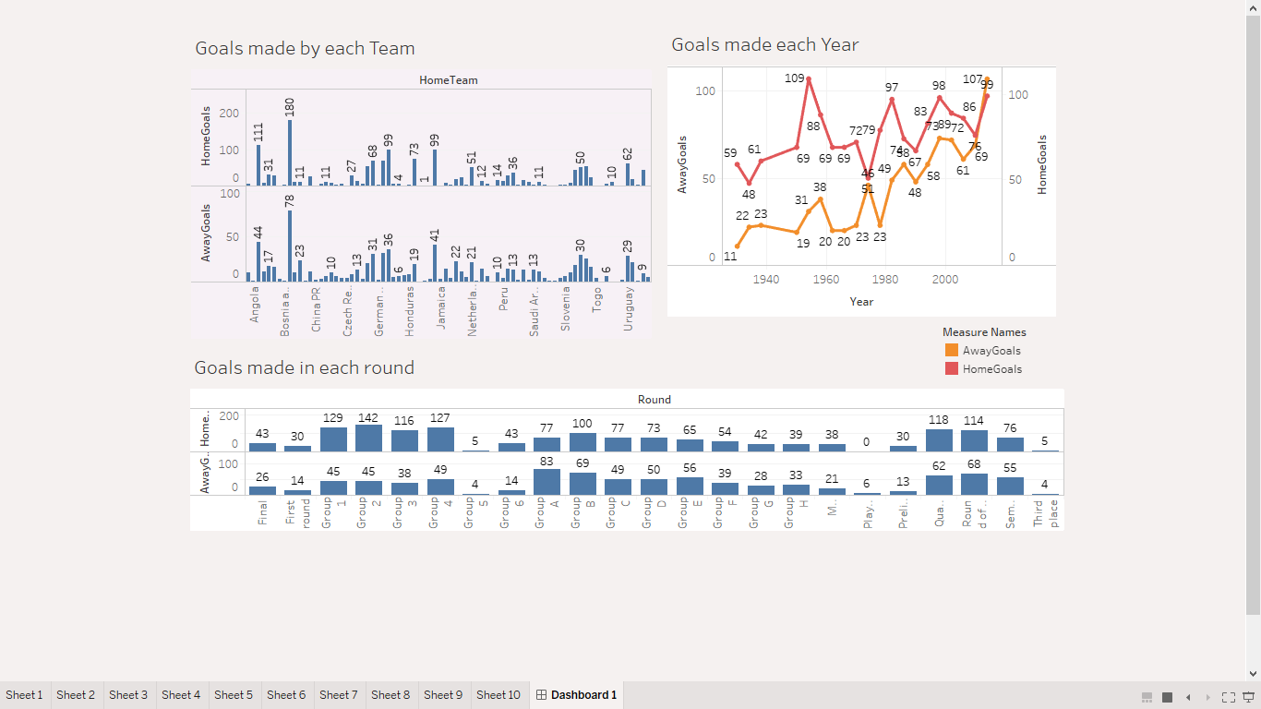
Dashboard
The data set shows that the total goals scored by a home team was much higher than the goals by away team. A valuable insight in the data. However, in 2014, did the away team score higher goals than the home team.

Slide 13
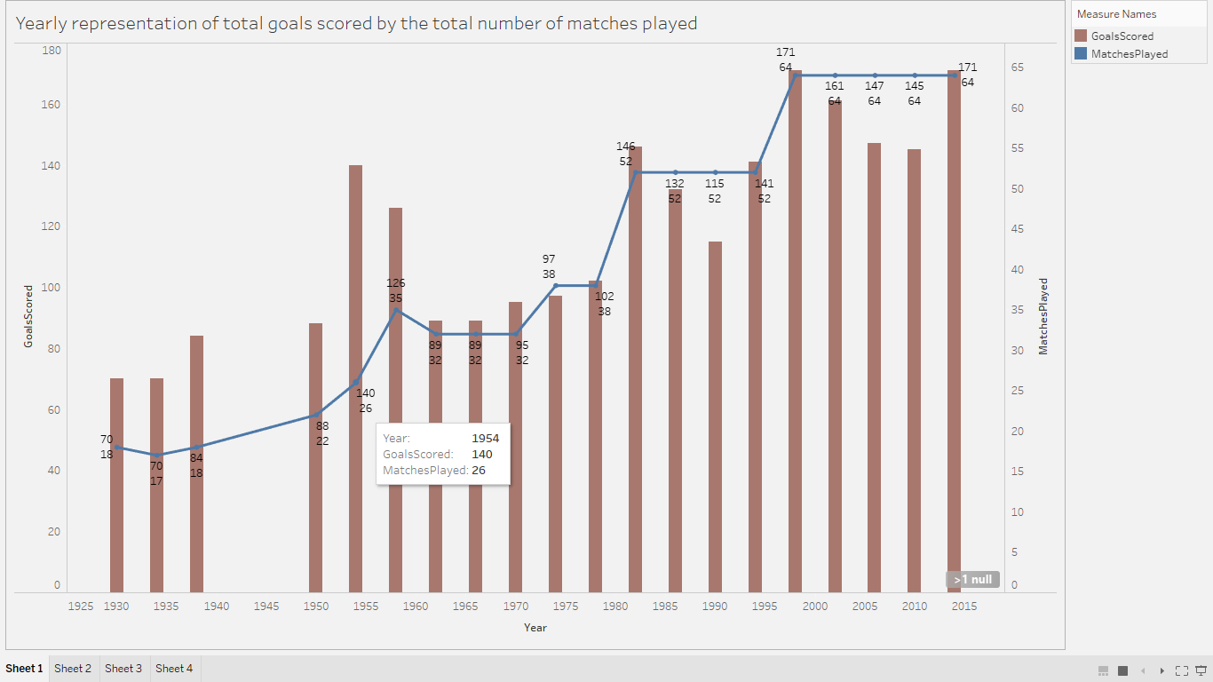
In the year 1954, the total goals scored was 140, while the total matches played where just 26. The only year that witnessed such a goal strike. Germany was the winner of this world cup.

Slide 14
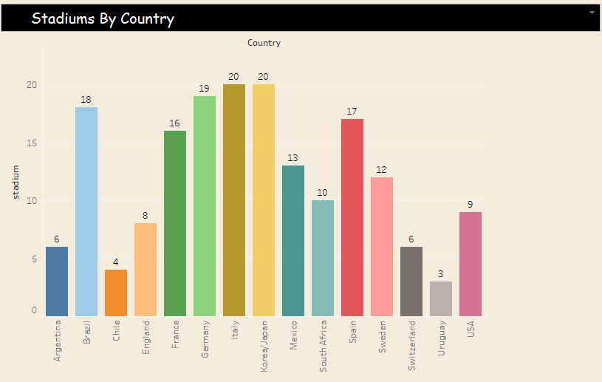

The above visualization depicts the number of stadiums across various Host Countries
We can find the maximum number of stadiums is in Italy(20).
We also find European countries have more stadiums than their Latin American Counterparts.

Slide 15
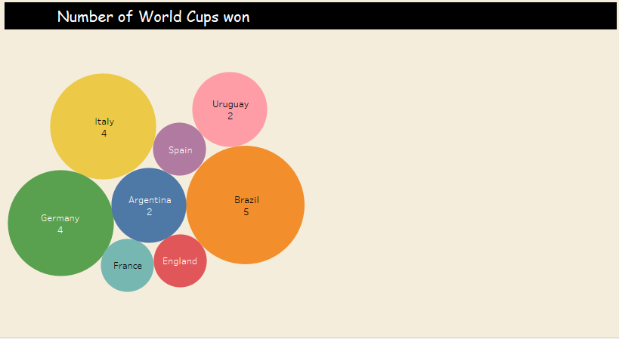


Slide 16
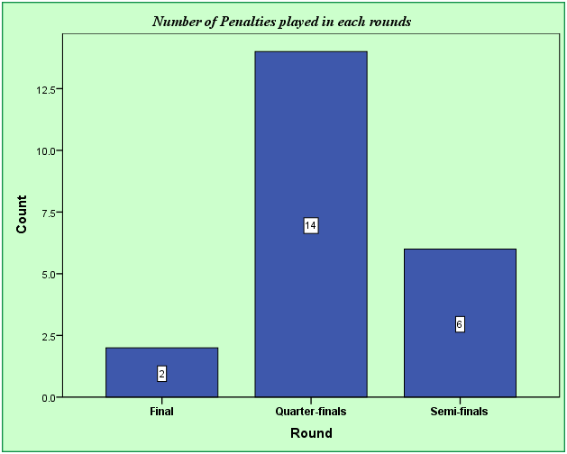
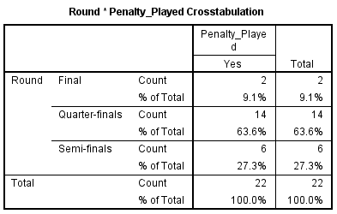
No. of Penalty Kicks / Goals scored across matches A penalty kick is awarded if a player commits a direct free kick inside their penalty area or off the field as part of play as outlined in laws. A goal may be scored directly from a penalty kick and has a high chances to qualify for the finals. Hence many kicks is found in Quarter finals such that the teams can qualify for the next rounds as Semi-Finals and finals. Count(penalty-kicks) : Quarter-Finals > Semi-Finals > Finals

Slide 17
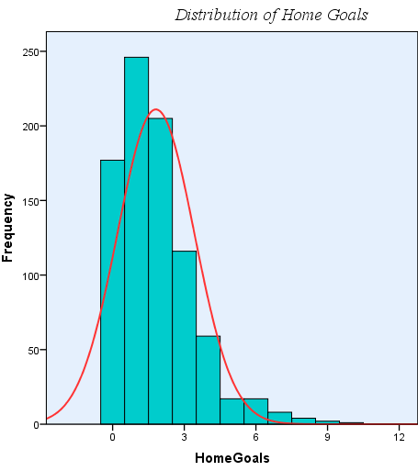
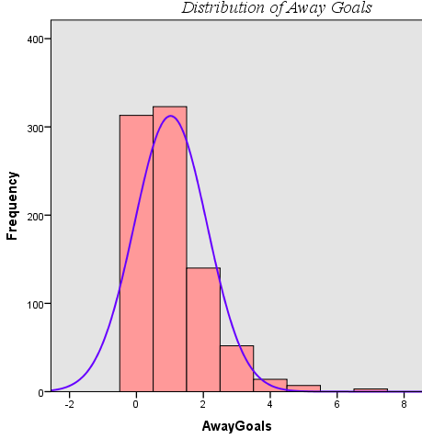
Both the graphs are skewed right, because there are countries (home or away team) who have scored more goals in order to compete and win FIFA a way greater than the mean value which is around 2.1 in home goals and 1.02 in Away goals. The mean value in both the graphs tells that there was a tough competition among the players to get the Championship.

Slide 18
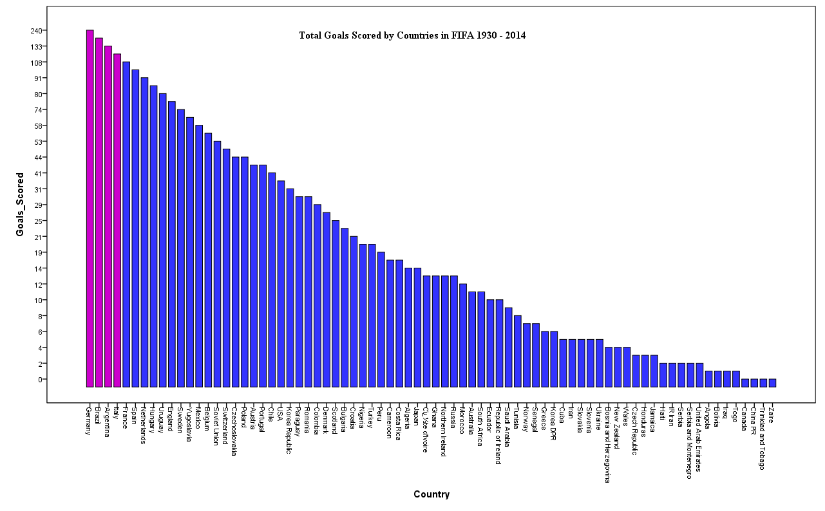
Germany has scored the maximum
Number of goals in the FIFA from
1930-2014.
The top 4 countries are listed here
Goals Scored in the season:
Germany > Brazil > Argentina > Italy

Slide 19
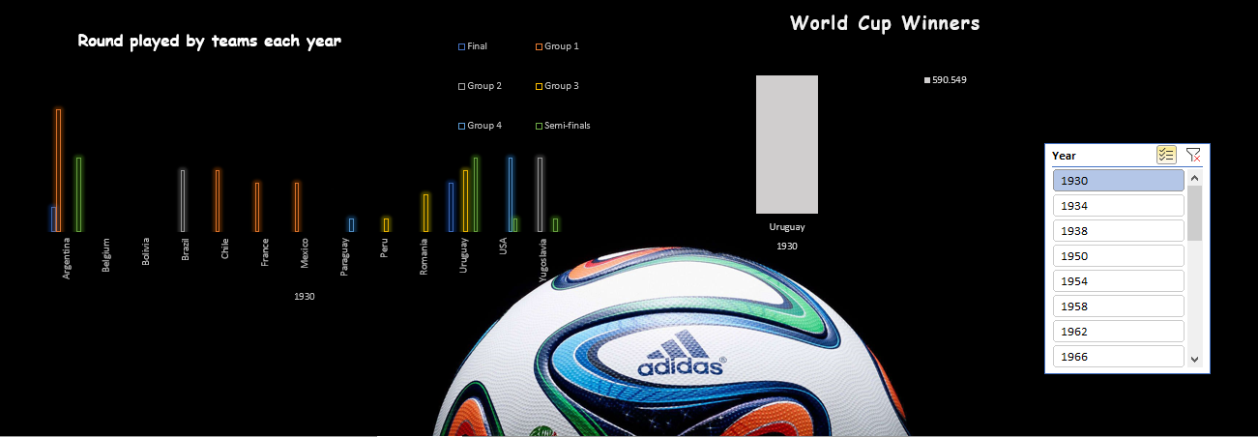
The Below dashboard was created using Excel and depicts the Rounds played by each team in 1930.

Slide 20
Key Findings from the Dataset
The world cup has been played every 4 years except in the year 1942 and 1946; the period of the World War 2.
The number of matches played has increased with each passing year as new countries participated in the World cup.
1994 World cup witnessed the highest number of attendees i.e. 35,87,538 while 1934 witnesses 3,63,000.
Brazil holds the record of winning the maximum number of times, Germany is close behind. However, Germany has played most of the quarter finals, semi finals and finals. Furthermore, Germany has scored the highest number of goals in the championship.
A major insight from the data was, on an average the home team scored more goals than the away goals, this behaviour has been shown in different rounds played in different years.
The basic assumption of people that if matches played is more, the goals scored would also be high was changed in the year 1954. This year 140 goals were scored in just 26 matches.
Looking at the various stadiums across the country, Italy has the maximum stadiums. Also the European countries have more stadiums that have hosted the World Cup compared to their Latin counterpart.
From the dataset we find that Italy(1934,1990),France(1938,1998),Brazil(1950,2014),Mexico(1970,1986) and Germany(1974,2006) has hosted most number of world cups.
The record for most number of matches played is for 2014 world cup(80).
NOTE: All the insights have been found after using BI tools like Tableau, Excel and SPSS. The use of action filter, dashboards and slicer has been implemented.

Slide 21

Thank You

